Slide 1
Cardiovascular Risk Prediction
By Hasna Akbar Ali

Slide 2
Problem Statement
What is the problem? To predict whether the patient has a 10-year risk of future coronary heart disease (CHD).
Why is it important to solve this problem?
Heart disease has become one of the most common cause of death.
Help diagnosticians reduce misdiagnosis.
How to solve this problem?
Thorough analysis of factors such as blood pressure, glucose levels, heart rate etc.
Use ML Algorithms to use these factors from almost 4000 rows.

Slide 3
Data Cleaning
Reformat strings - Ensure consistent and standardized formatting for string data (converting to snake_cases from camCase).
Reformat data types - Convert data to appropriate data types (e.g. object to category) for accurate analysis.
Address missing values - Handle missing data by filling or removing incomplete entries.
Address duplicate values - Identify and remove or manage duplicate records to avoid redundancy.
Address the outliers - Detect and address extreme or unusual values that may skew analysis.
Remove irrelevant observations - Exclude irrelevant or unnecessary columns that do not contribute to the analysis.

Slide 4
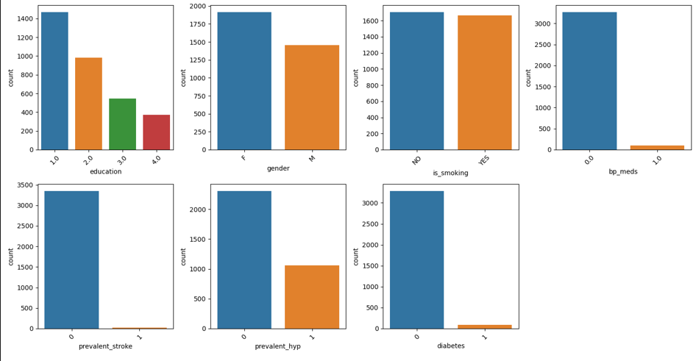
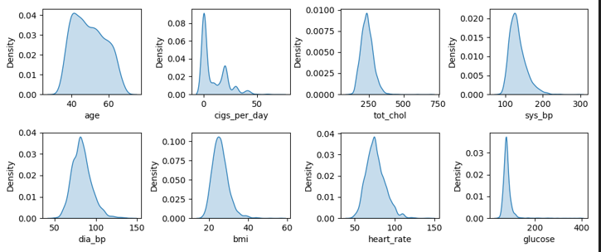
EDA (Exploratory Data Analysis)
Univariate Analysis

Slide 5
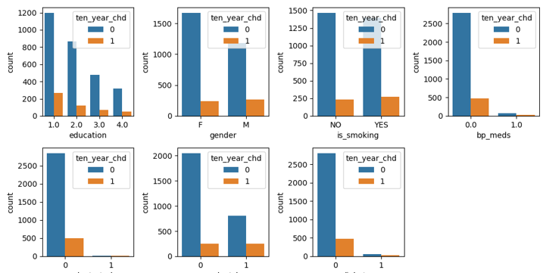
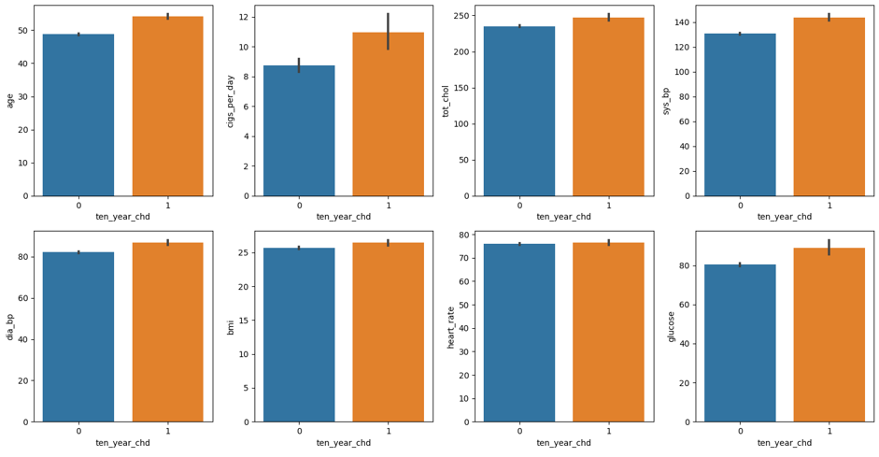
2. Bivariate Analysis

Slide 6
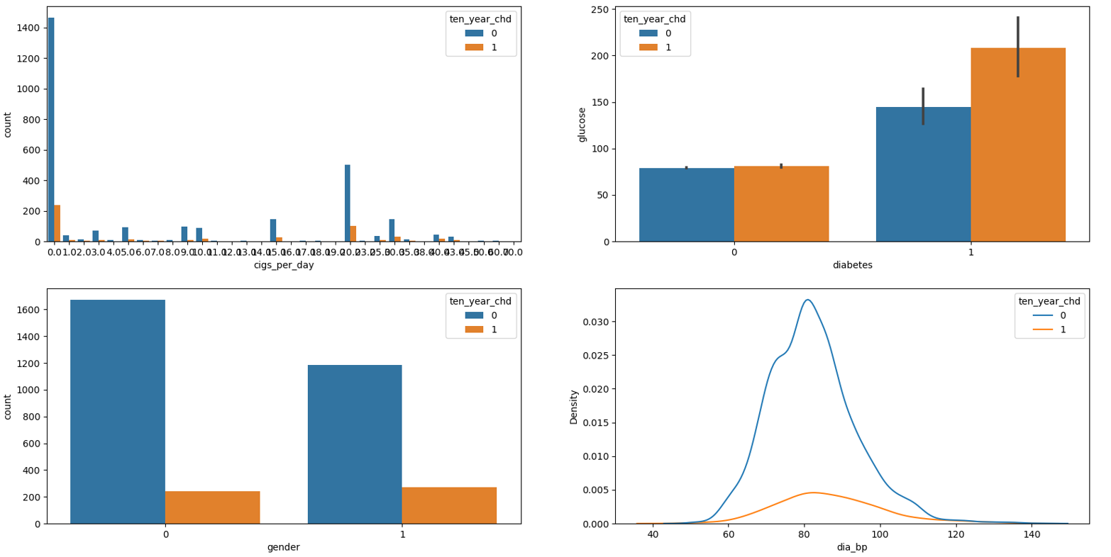
3. Multivariate Analysis

Slide 7
Insights from Analysis
Predominantly the smokers with CHD mostly smoke 15-20 cigs a day.
Smokers are more prone to heart diseases by 7.27% than Non Smokers.
Men are 6.09% more prone to heart disease than women.
There are 2 features that talk about smoking, is_smoking feature is basically covered within the cigs_per_day feature as the cigarettes a non smoker would use is 0 as per the recorded data.
Systolic BP, Diastolic BP are used to identify different levels of Blood Pressure, Systolic BP is more useful to identify CHD.
The glucose level of people that have CHD is mostly 72-78 mg/dl.

Slide 8
Model Selection
Logistic Regression - Logistic regression is a supervised learning classification algorithm used to predict the probability of a target variable.
Decision tree - A tree-like model to predict the target variable's value based on input features. It recursively partitions the data into subsets by selecting features that best separate the data.
Random Forest Classifier- This model uses multiple decision trees to get more accurate predictions and reduce overfitting.
K-Nearest Neighbors - KNN has the goal is to classify a new data point/observation into one of multiple existing categories.
Support Vector Machine - SVM is used to plot each data item as a point in n-dimensional space (where n is number of features you have) with the value of each feature being the value of a particular coordinate.
Gaussian Naive Classifier- Classification algorithm that predicts the probability of each data point belonging to a class and then classifies the point as the class with the highest probability.

Slide 9
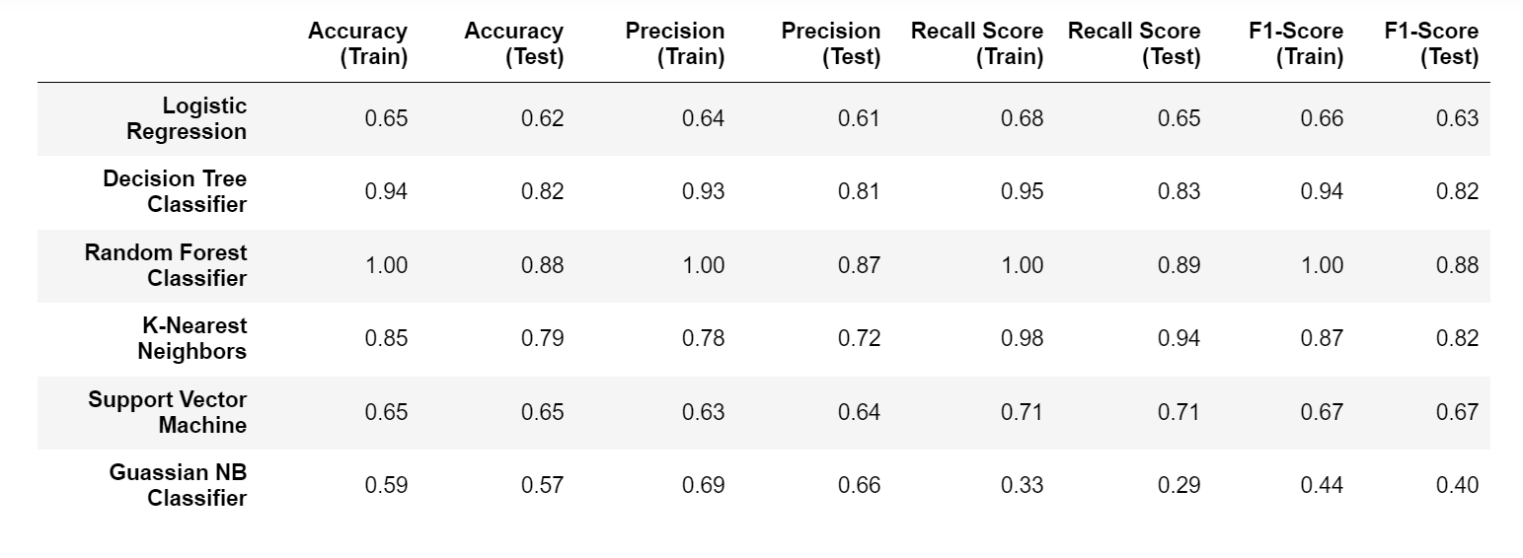
Results of Selected Models

Slide 10
Conclusion
The Decision Tree Classifier is a strong performer for this task, with high accuracy and precision.
K-Nearest Neighbors (KNN) demonstrates good recall but needs improvement in precision.
The Random Forest Classifier is a robust choice, delivering high accuracy and precision. But there seems to be an issue of overfitting
Logistic Regression and SVM shows moderate performance, with room for improvement in accuracy and precision. On the other hand, The Gaussian NB Classifier shows lower recall and overall moderate performance.

Slide 11
THE END

